Slide 1
What happens when a computer tries to remember too much?
https://tinyurl.com/not404actually

Slide 2
Presentation outline
What is a computer, actually.
The widely spread memory model.
The nerdier memory model*.
Ok let’s hack* Google!!1!

Slide 3
Presentation outline
What is a computer, actually.
The widely spread memory model.
The nerdier memory model*.
Ok let’s hack* Google!!1!

Slide 4
Computers execute binary instructions from memory,
one thing at a time
Computer
Memory:
Instructions
Data

Slide 5
Computers execute binary instructions from memory,
one thing at a time
Computer
Memory:
Instructions
Data
Tick
Tock

Slide 6
Harvard architecture separates “program” from “execution”
Program
Execution
Computer

Slide 7
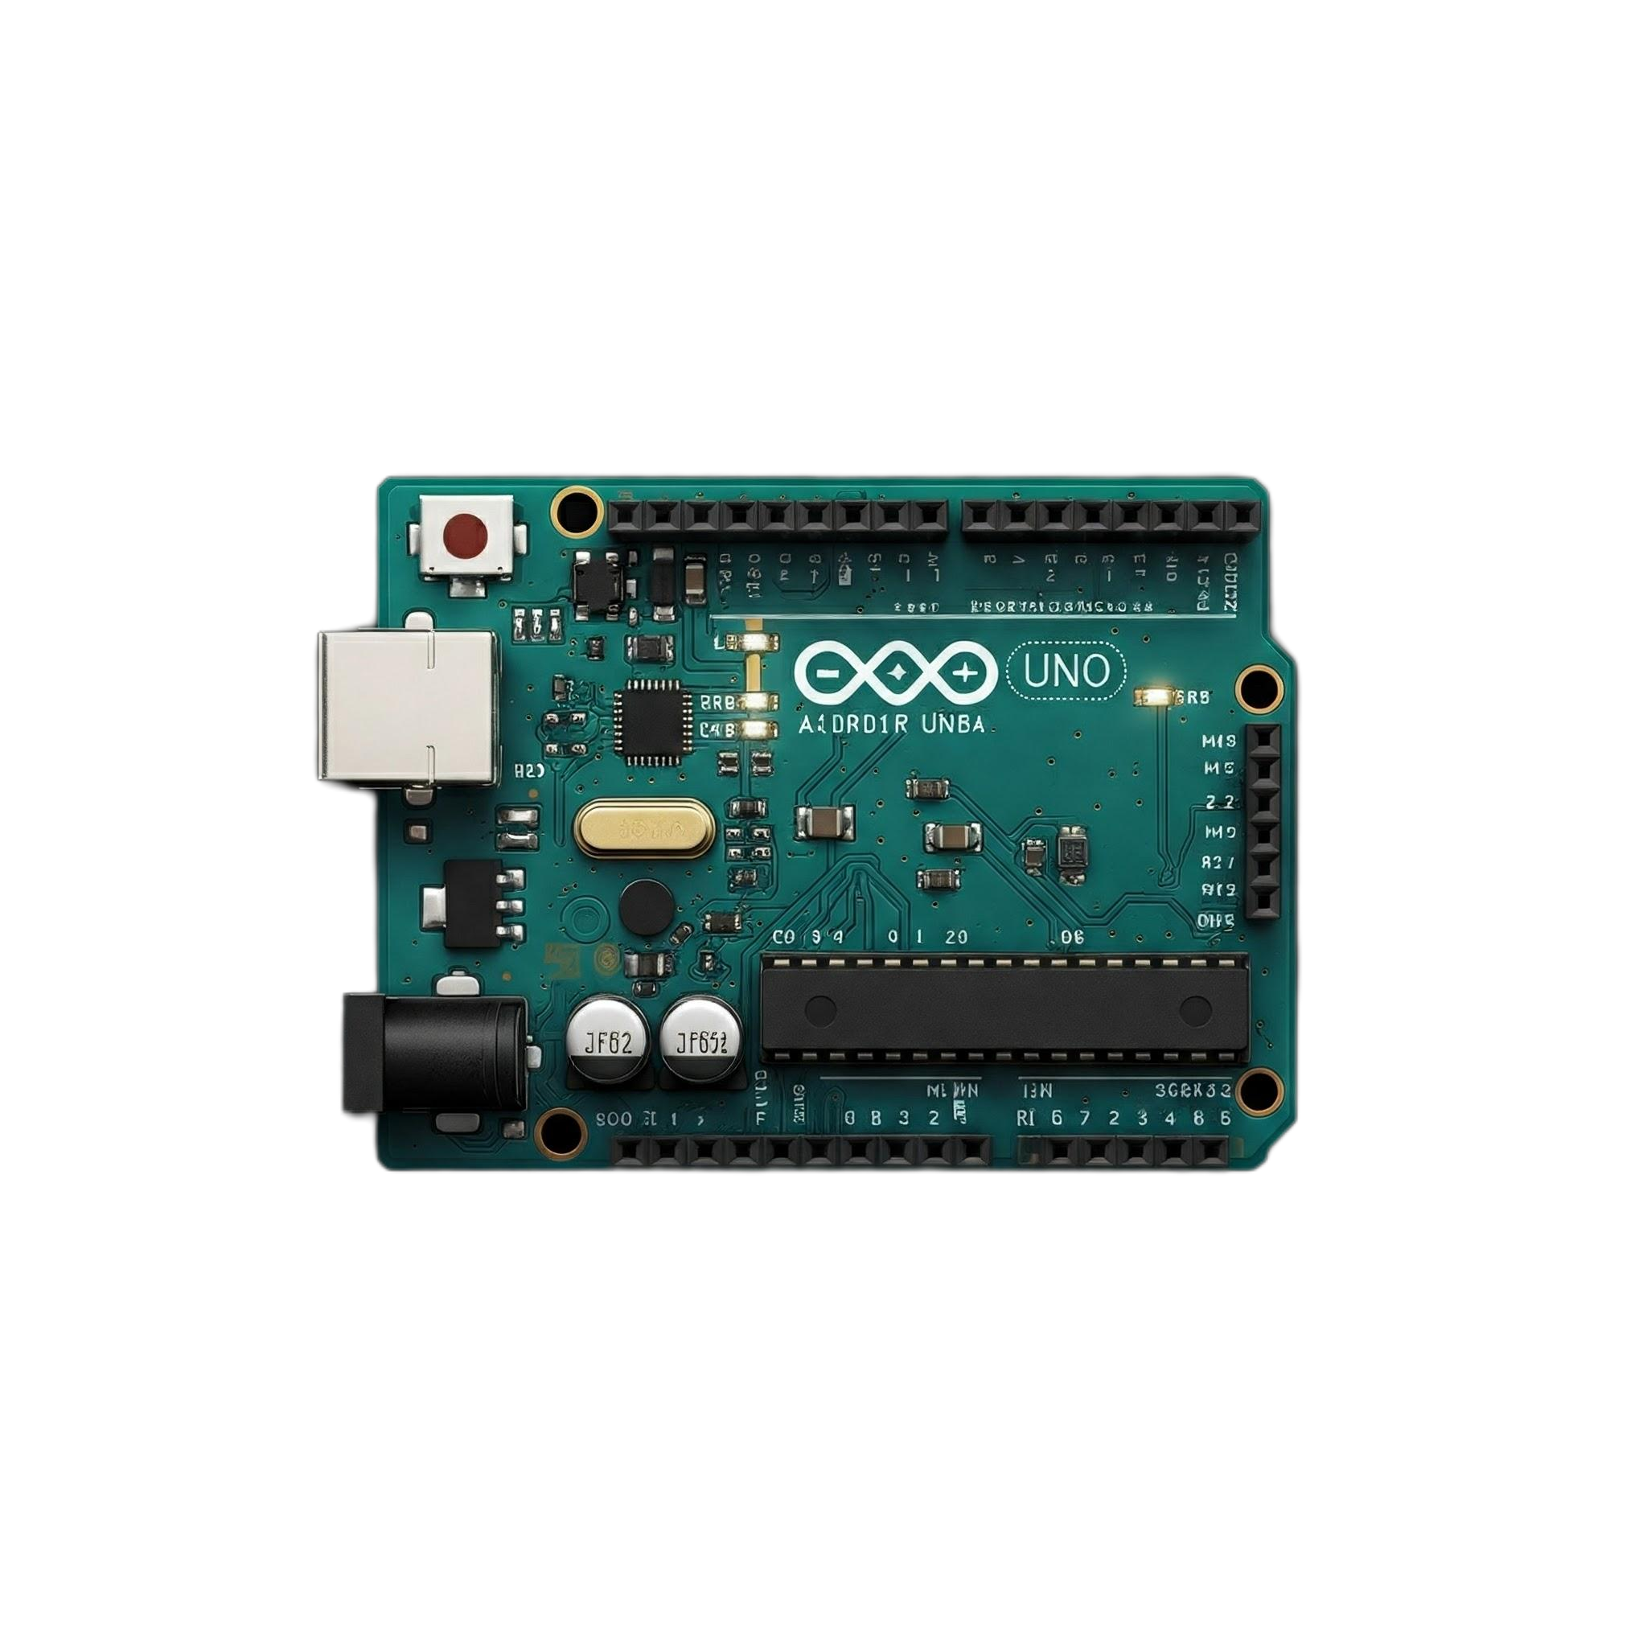
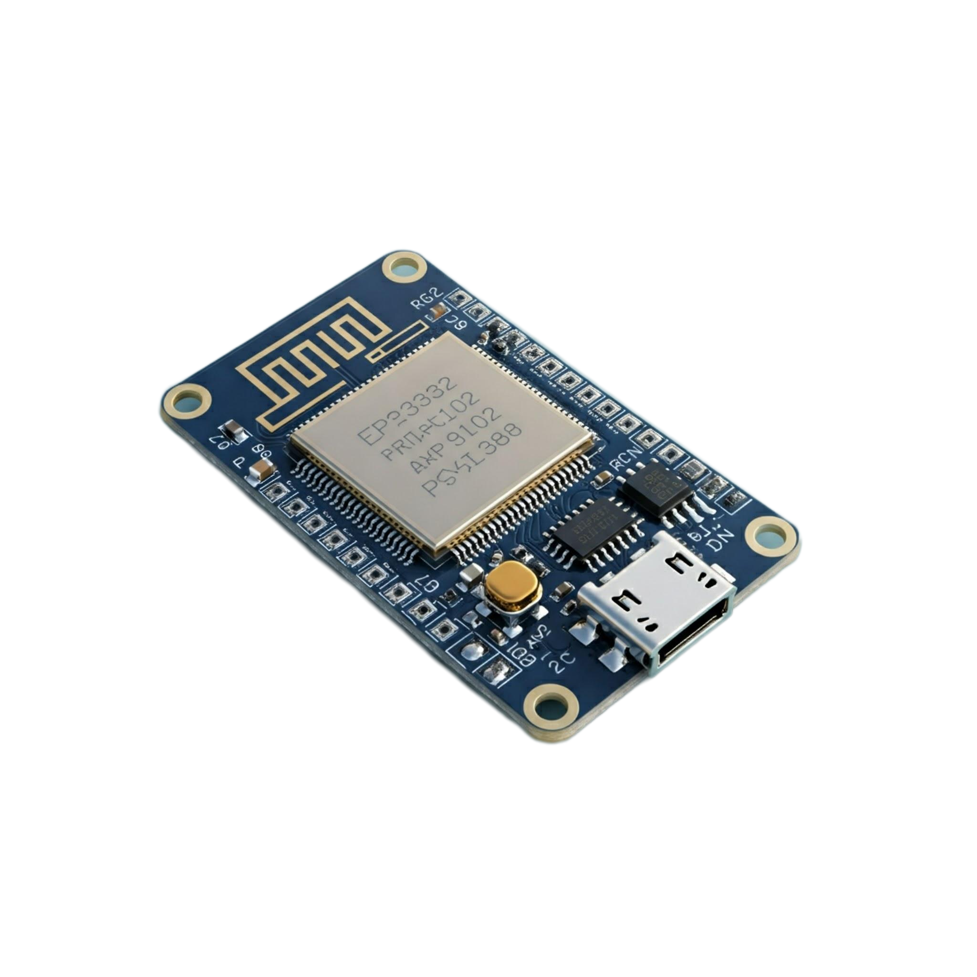
Harvard architecture is common among microcontrollers
Arduino
ESP32

Slide 8
Princeton architecture groups everything
Data, in general
Computer

Slide 9
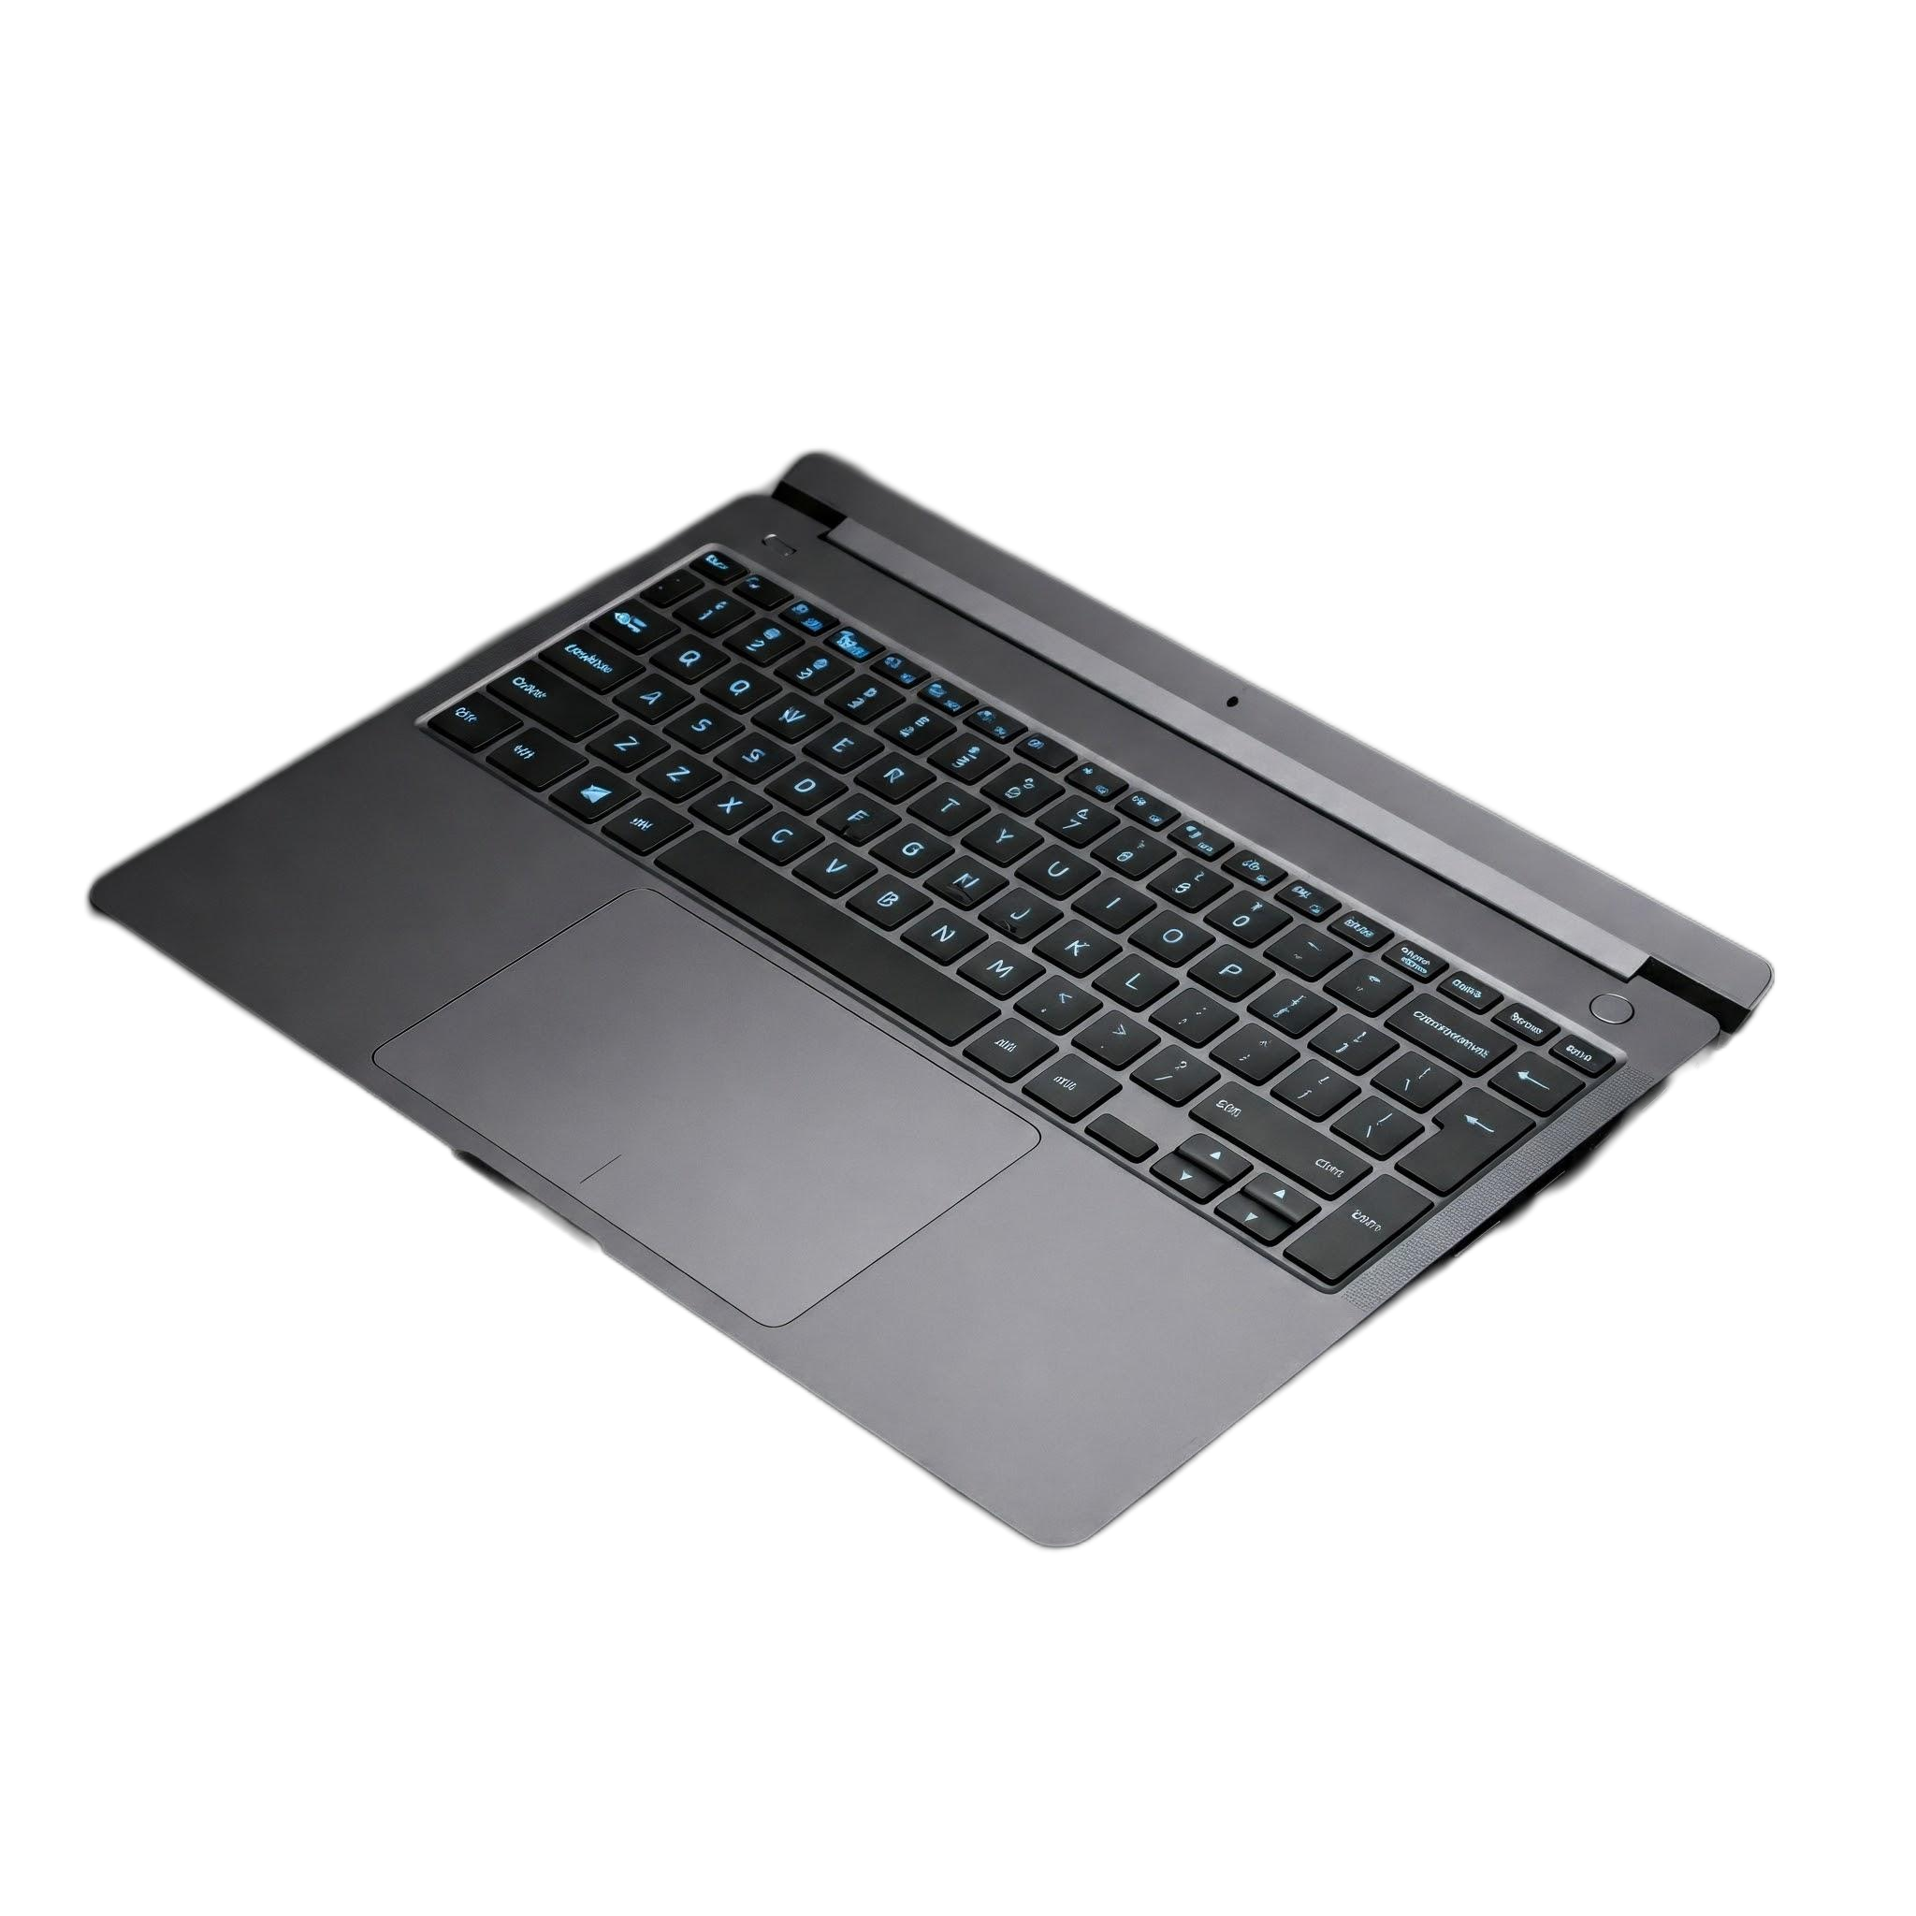

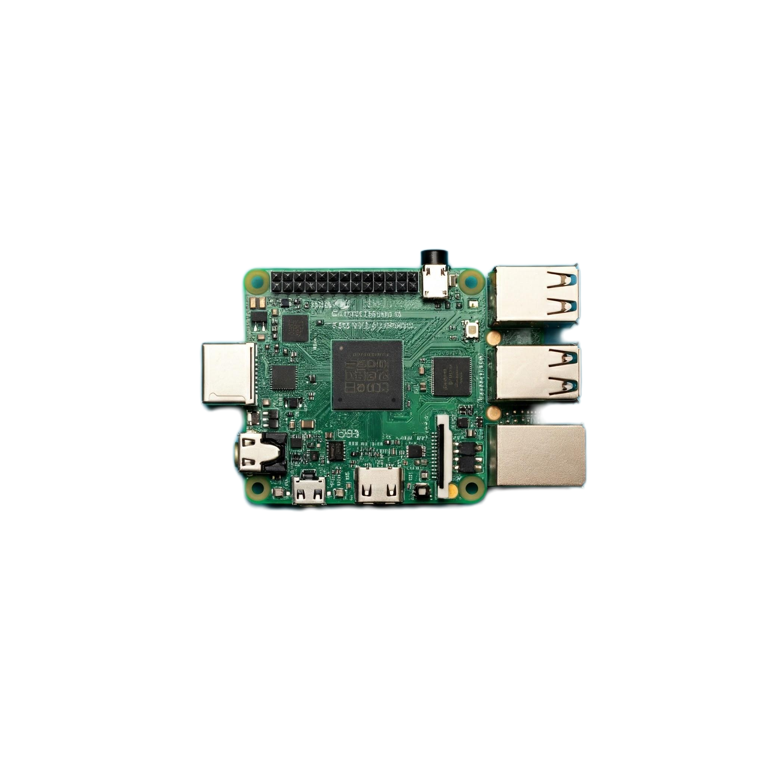
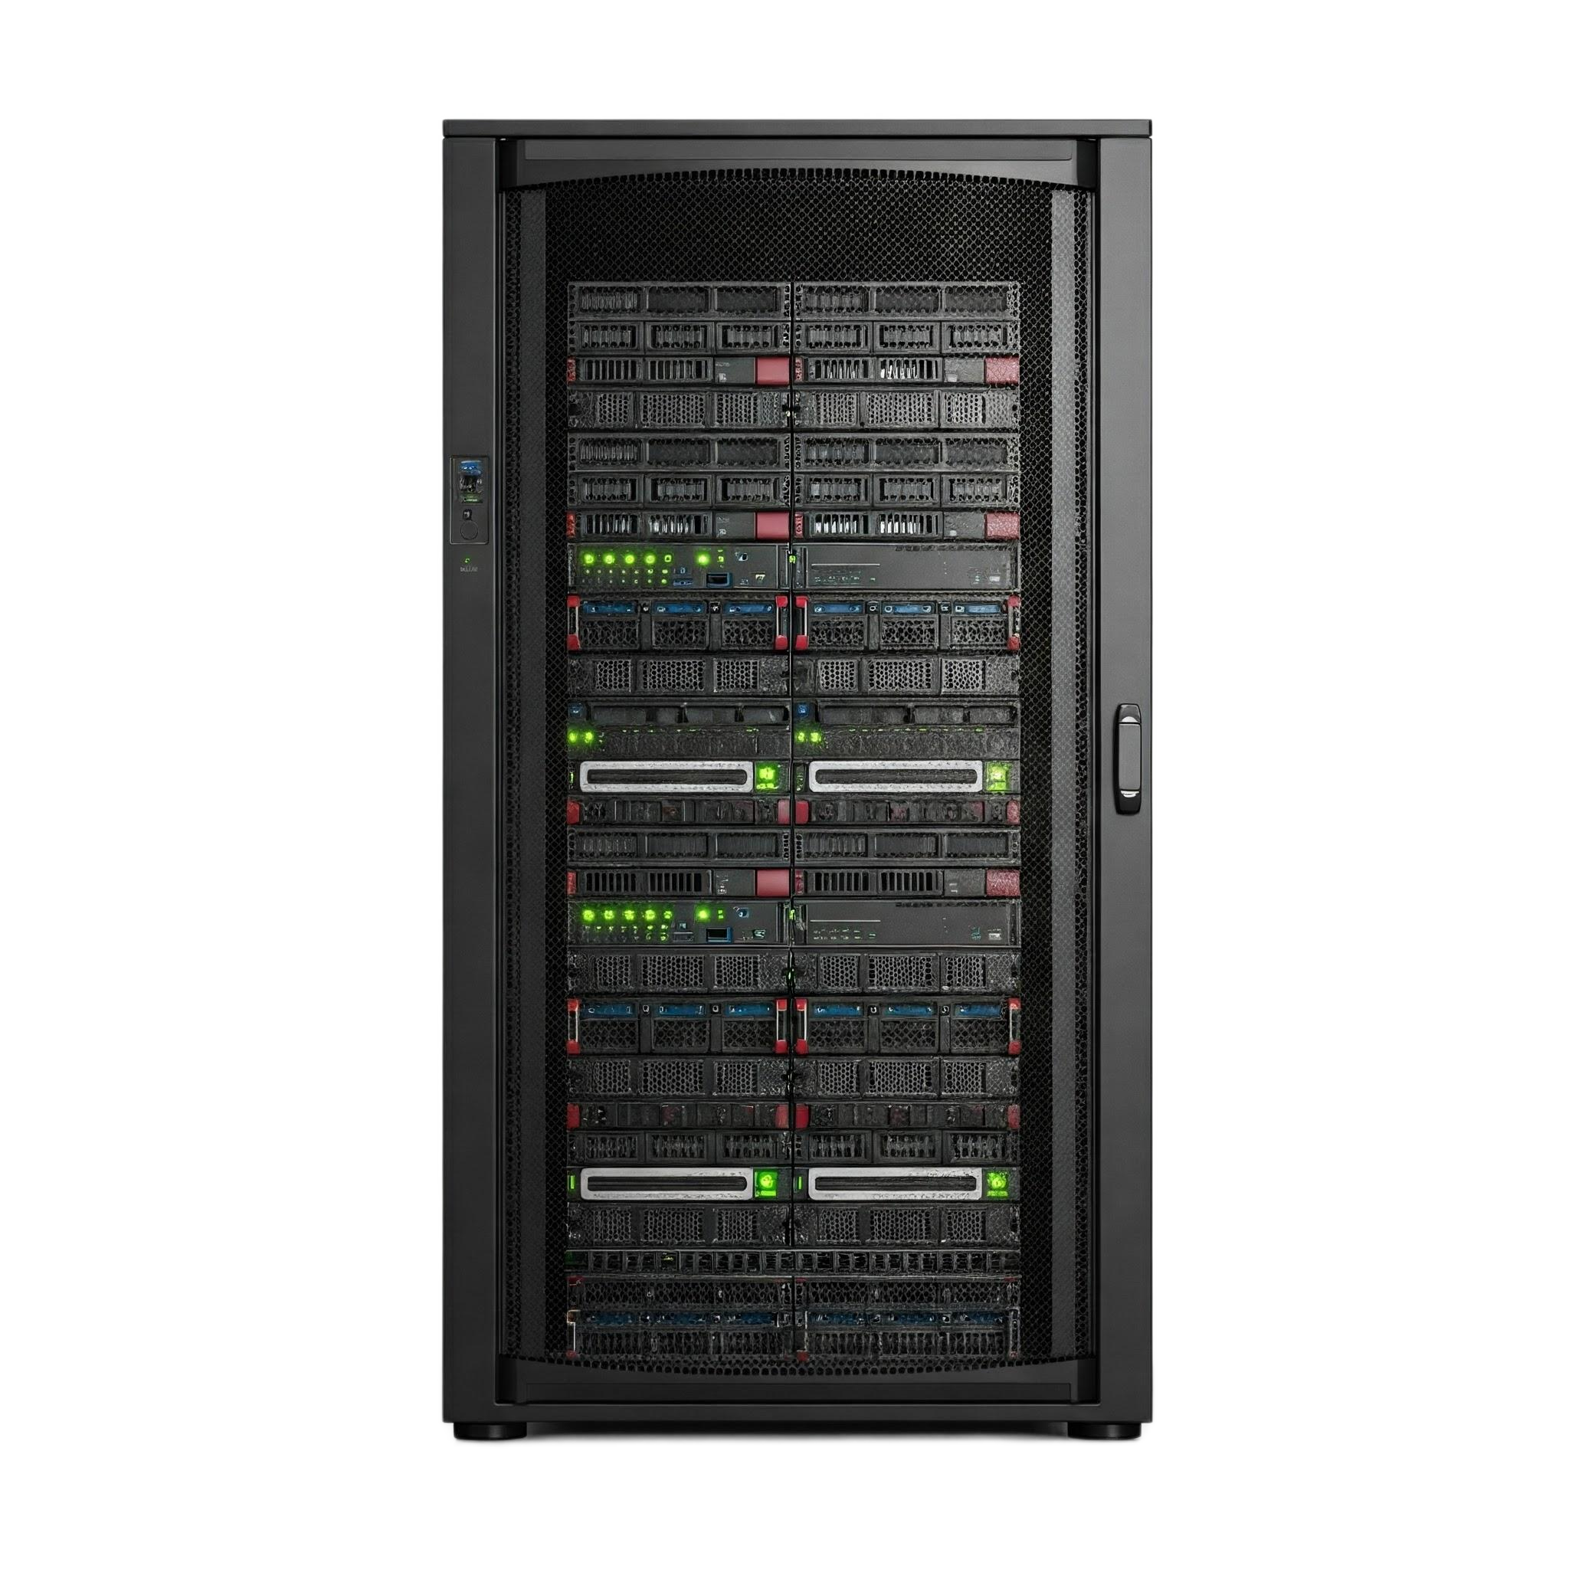
Princeton* architecture is the norm
Laptops
Phones
RaspberryPi’s
Servers

Slide 10
Presentation outline
What is a computer, actually.
The widely spread memory model.
The nerdier memory model*.
Ok let’s hack* Google!!1!

Slide 11
Latency is ETA, bandwidth is number of traffic lanes
Latency of memory is the time it takes between the request and data arrival
Bandwidth of memory is how much data can be moved per unit time
Computer
Memory
Computer
Memory

Slide 12
The computer lives in RAM and interacts with HDD
HDD
RAM
Massive latency, poor* throughput
Less latency, better throughput
Computer

Slide 13
HDD is permanent and RAM is volatile
RAM is much smaller than HDD
HDD can be disk or solid state
Drastically different latency and random access performance
Computers can use HDD when they run out of RAM (swap)
Data from HDD can be cached in RAM (superfetch)

Slide 14
Presentation outline
What is a computer, actually.
The widely spread memory model.
The nerdier memory model*.
Ok let’s hack* Google!!1!

Slide 15
Current memory model
RAM
Behaviour:
Constant latency, regardless of size
Constant bandwidth, regardless of size
Computer

Slide 16
The Arduino has Flash and SRAM*
Program
Execution
Theoretically, it follows our model
Are flash and RAM equal?
Are latency/bandwidth really constant?
Computer

Slide 17
General procedure to test memory
Repeat the test several times to get rid of cold effects
Test for increasingly large regions of memory
Normalize the result to a per element basis

Slide 18
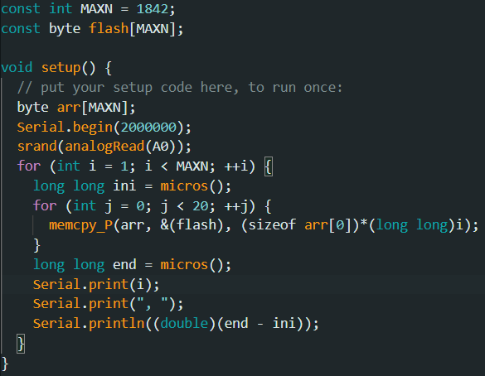
Copying flash to RAM: the code following the procedures

Slide 19
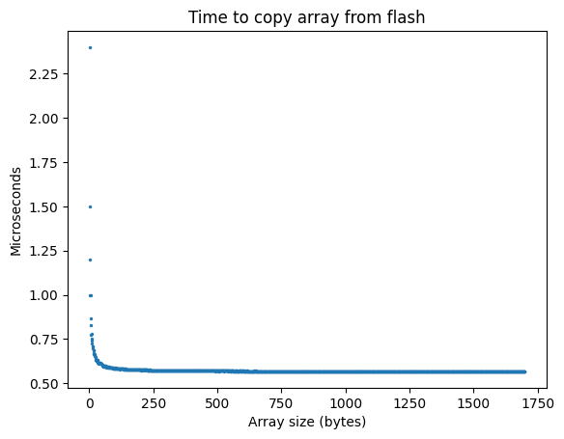
Copying flash to SRAM: the results are (not!) exciting
This is a pattern that will constantly repeat due to test overhead et al

Slide 20
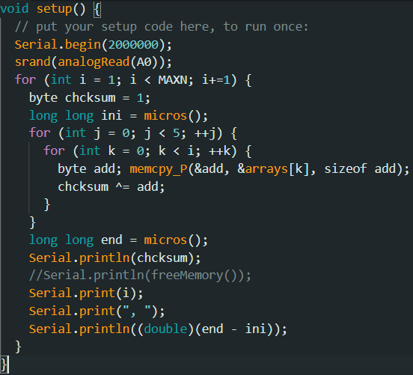
Flash bandwidth code: copy from flash each element

Slide 21
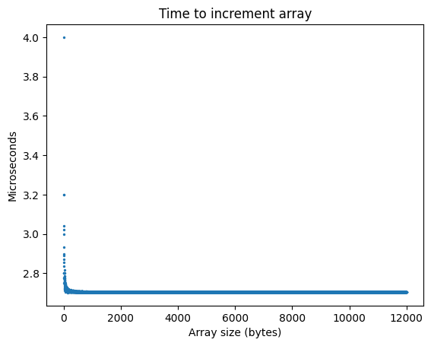
Flash bandwidth is also (not!!) exciting

Slide 22
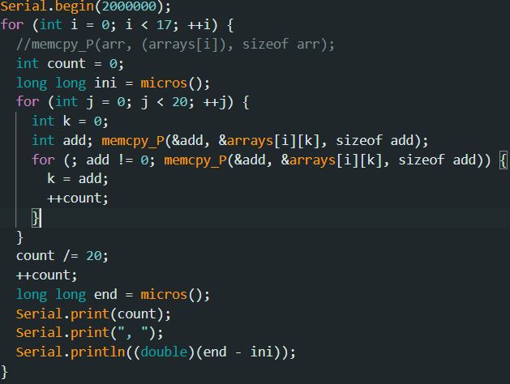
Flash latency code: iterate randomly through array

Slide 23
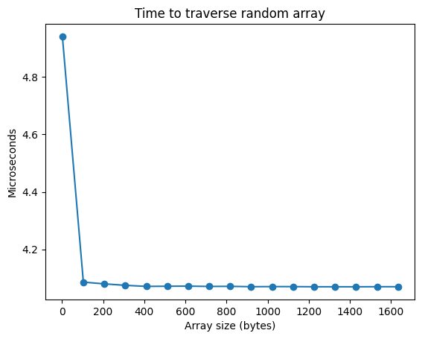
Flash latency is not exciting (Arduinos really are simple)

Slide 24
The ESP32 has Flash and SRAM*
Program
Execution
Theoretically, it follows our model*
Are latency/bandwidth really constant?
Computer

Slide 25
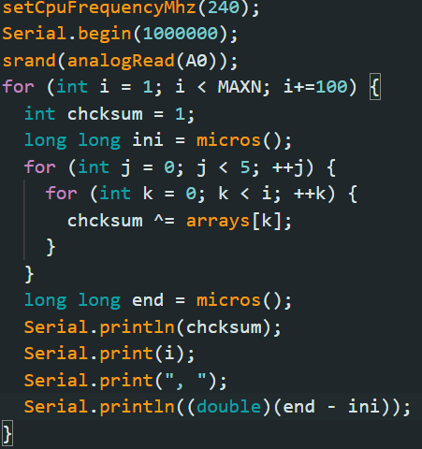
Flash bandwidth code

Slide 26
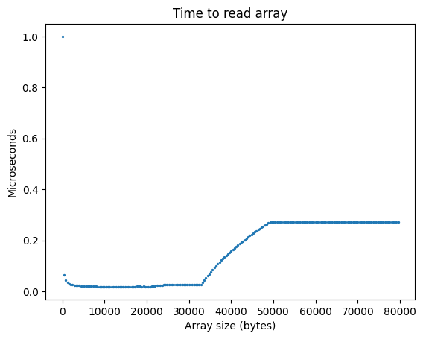
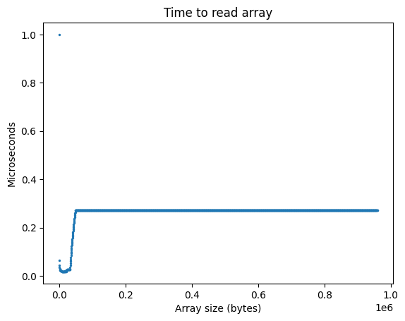
Bandwidth exhibits a weird dip

Slide 27
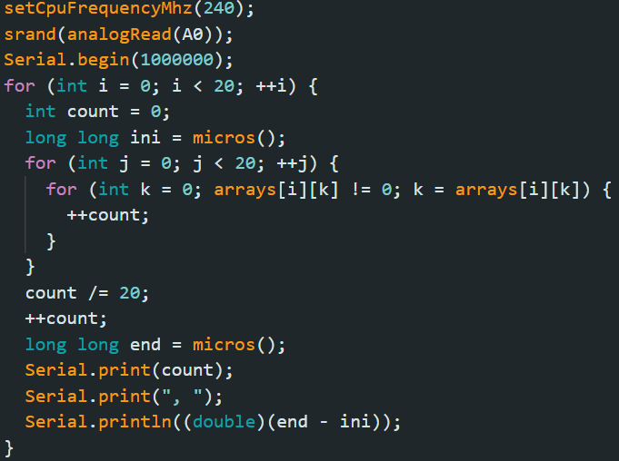
Flash latency code

Slide 28
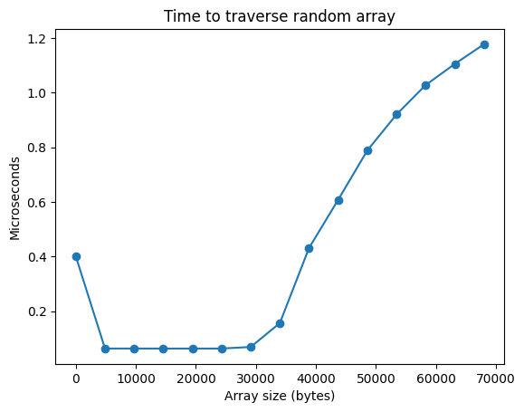
Latency appears to increase after the same size

Slide 29
Cache is a faster, much smaller memory
Flash
Every time the computer retrieves something from memory, it is stored in cache
Cache is small, so if it doesn’t have space old data is kicked out
Cache has much higher bandwidth and much lower latency
Cache
RAM
Computer

Slide 30
Cache explains the ESP32 behaviour (32kB)

Slide 31
The Raspberry has cache and RAM
RAM
Theoretically, it follows our model*
Do we see the steps like the in the ESP32 graphs?
Cache
Computer

Slide 32
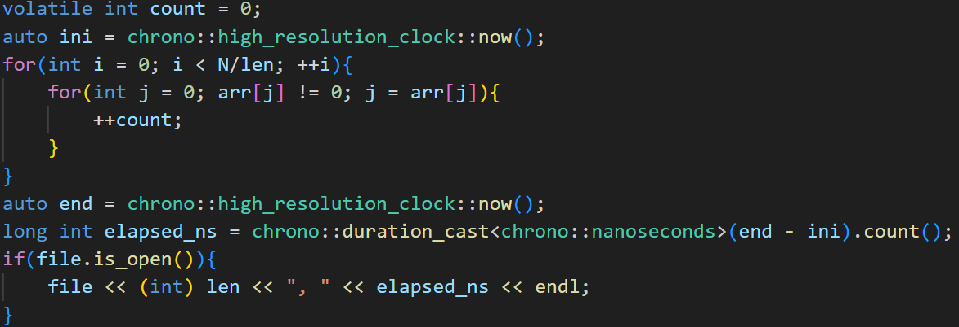
Memory latency code

Slide 33
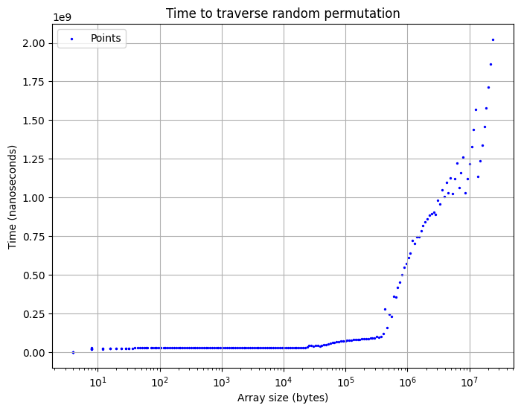
Memory latency results seem consistent

Slide 34
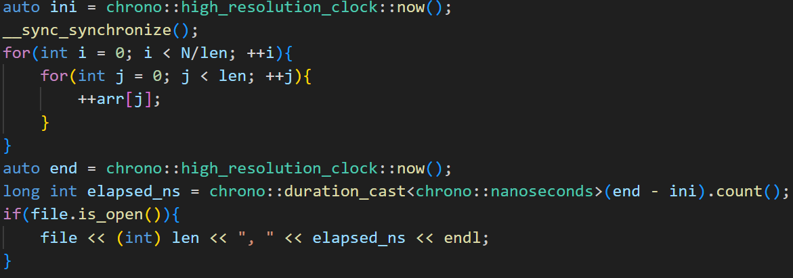
Memory bandwidth code

Slide 35
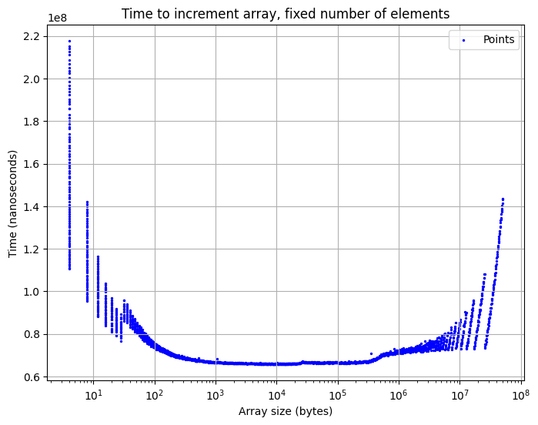
Memory bandwidth seems normal-ish

Slide 36
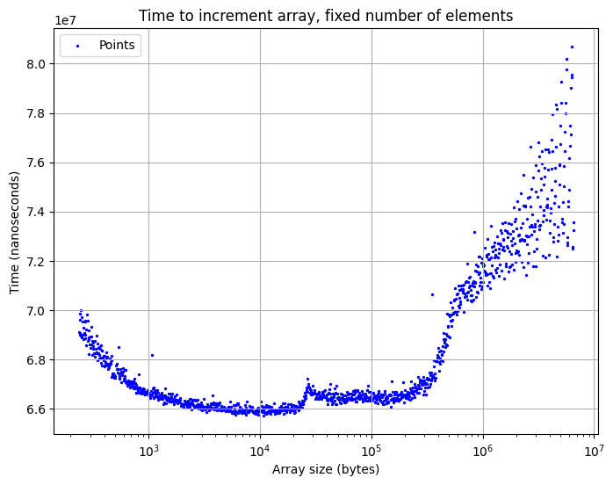
Or not! The zoomed in version shows more steps

Slide 37
The Raspberry has two levels of cache!
Data first arrives in L1
Old data is expelled to L2, only then to RAM
If something from L2 is called, it returns to L1
RAM
L2 cache (512 kB)
L1i cache (16 kB)
L1d cache (16 kB)
Computer

Slide 38
This agrees with our data closely (two steps)

Slide 39
x86 computers have RAM and multiple layers of cache
Theoretically, it follows our model*
Do we see the steps like the in the Raspberry graphs?
Does accessing data close to each other yield the same bandwidth?
RAM
L3 (12 MB)
L2 (1280 kB)
L1d (48 kB)
L1i (32 kB)
Computer

Slide 40
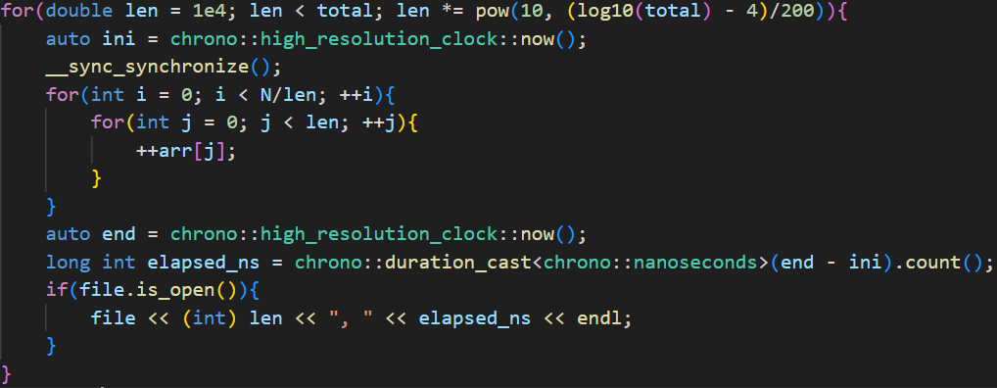
Bandwidth code

Slide 41
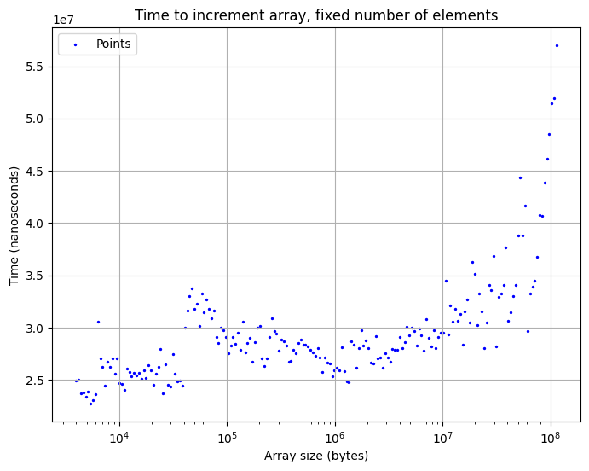
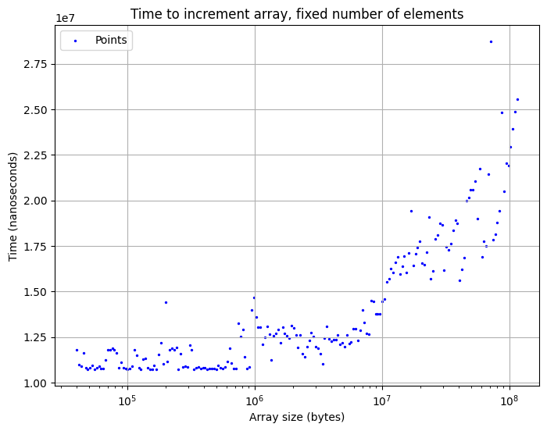
Bandwidth results

Slide 42
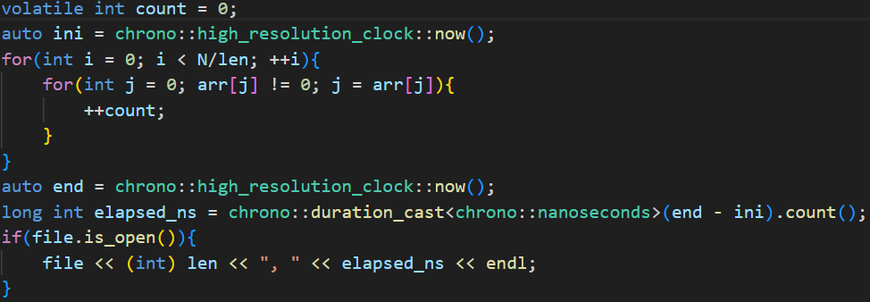
Latency code

Slide 43
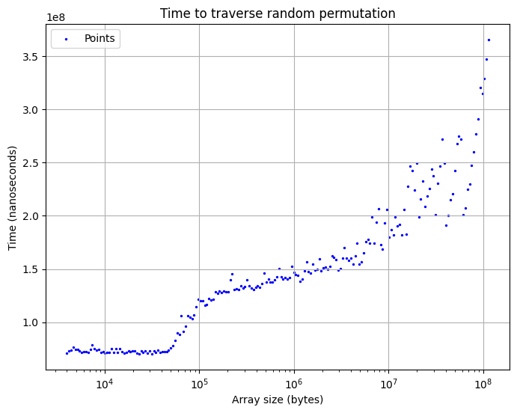
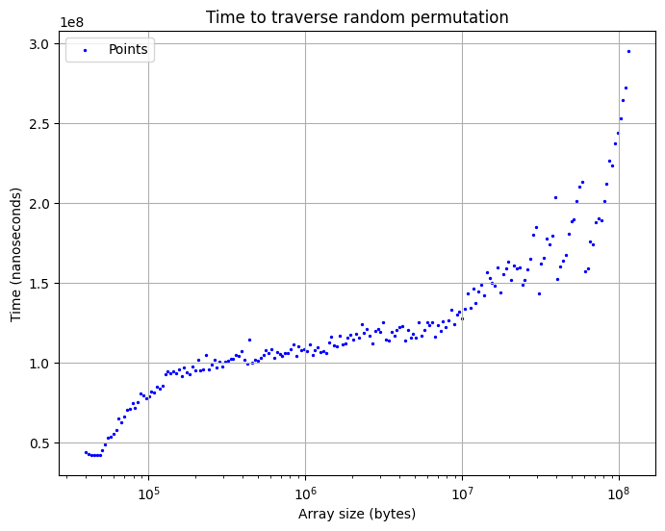
Latency results

Slide 44
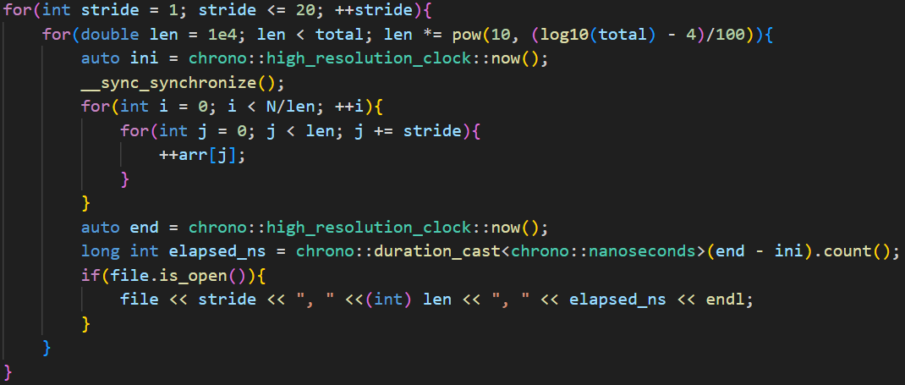
Strides code

Slide 45
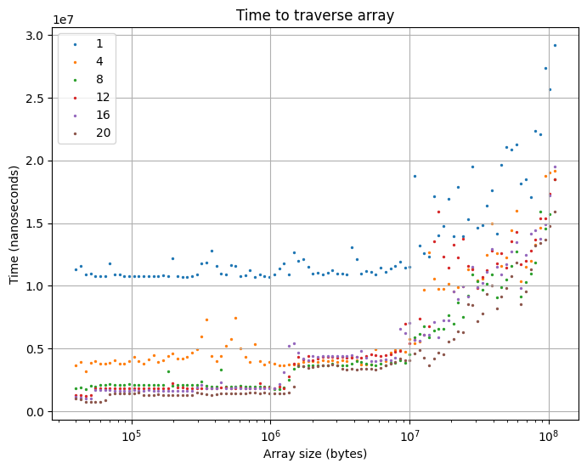
Strides bandwidth

Slide 46
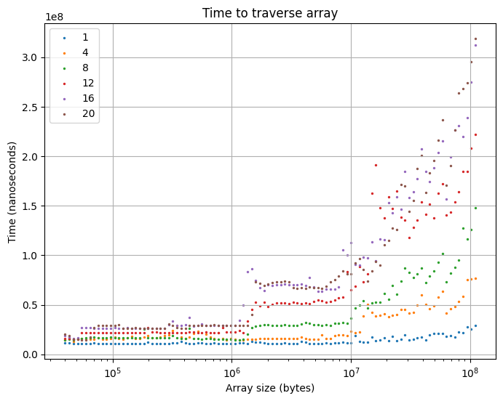
Strides bandwidth, normalized per element

Slide 47
Cache is fetched in batches of 64B
64B
64B
64B
64B
64B
64B
64B
64B
64B
64B
64B
int 1; int 2; int 3; …
Larger strides use more cache lines
The computer processes integers faster than they can be fetched
The computer ends up bottlenecked by the fetching stage

Slide 48
Presentation outline
What is a computer, actually.
The widely spread memory model.
The nerdier memory model*.
Ok let’s hack* Google!!1!

Slide 49
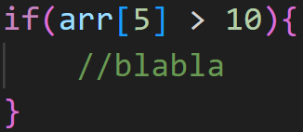
Computers hide latency with speculative execution
Needs to retrieve from cache, possibly even RAM
The computer predicts the outcome so it doesn’t have to wait
When the value arrives, the computer undoes its execution if the prediction was wrong

Slide 50
The spectre hardware vulnerability is very serious
Discovered in 2018 by Google researchers and others
Affects ~every Intel CPU since 1995-ish, not yet solved but mitigated
Programs exploit the memory system and speculative execution to learn what is in memory they don’t have access to (passwords, etc.)

Slide 51
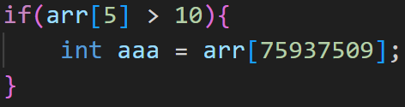
Speculative execution can promote things to L1
Even if predicted wrong, arr[75937509] will remain in cache

Slide 52
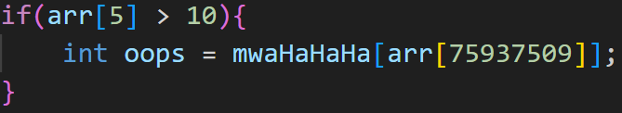
Spectre checks access latency
Even if the computer realises arr[75937509] shouldn’t be accessed,
mwaHaHaHa[arr[75937509]] will have been promoted. But accessing mwaHaHaHa later is fine!

Slide 53
Let’s hack google!!!1!

